Slide 1
COMPUTER SOFTWARE
By Walubita.N.
Kapasa Makasa University

Slide 2
SOFTWARE
Software is a set of instructions, data, or programs that tell a computer what to do and how to do it.
Thus based upon the tasks performed by the software, softwares are broadly classified into following two categories:
System Software
Application Software

Slide 3
System Software
System software is a type of computer program that manages and controls a computer's hardware and application software, acting as a bridge between the two.
Following are the names of few system softwares, which are essentially required for normal functioning of computer system.

Slide 4
Operating System
An operating system (OS) is system software that manages a computer's hardware and software resources, acting as an interface between the user and the computer. It handles tasks like memory management, process scheduling, and input/output operations, enabling applications to run and interact with the hardware. Examples of OS is Windows 11, Kali, Parrot,Android etc.

Slide 5
Utilities software
All those softwares, which safeguard the computer and its resources from hazards or ensure its proper functioning or build an efficient working environment are called utilities. Utilities are basically system software. For example, data compression utilities, virus protection utilities, disk fragmentation utilities etc. are system software.

Slide 6
Device Drivers
That software, which is written with the objective of making a device functional when it is connected to the computer, is called device driver. For example, device driver for web camera, device driver for light pen, device driver for printer etc. are example of system software.

Slide 7
Application Software
Application software is a type of computer program designed to perform specific tasks for users, rather than managing the computer's internal operations. It's essentially any program that allows users to interact with the computer to achieve a particular goal, whether it's for personal, educational, or business purposes

Slide 8
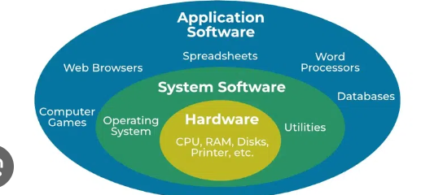

Slide 9
Firmware
Firmware is a type of software that's embedded within hardware devices to control their basic functionality. It's essentially "software for hardware" that helps a device boot up, communicate, and perform core tasks. Unlike regular software that is installed and updated, firmware is often stored in non-volatile memory (like ROM or flash memory) and may be updated through dedicated procedures

Slide 10


